Slide 1
ORL 5524-Session 10.0
Instrument Design and Validation—Performance assessments, rating scales and rubrics
Madhabi Chatterji, Ph.D.
Professor of Measurement, Evaluation and Education
Director, Assessment and Evaluation Research Initiative (AERI)
Teachers College, Columbia University

Slide 2
AGENDA
Review of domain specs. and initial items homework
(Janhavi)
Lecture-Discussion on Performance Assessments, Rating Scales and Rubrics
  Readings: Chapter 8, Chatterji (2003), PLUS new Chapter 6 (Chatterji, in press/Guilford) posted in previous weeks
Student Papers –examples of content validation and cognitive interviewing applications
  Readings (for next week ): Polit et al (2007) paper posted today, and
  Carbone et al paper posted today, in prep for lecture next week
Content validation of your own items (work in teams or pairs)
  Begins this week, continue on your own.

Slide 3
Today’s Focus
: Commonly used Assessment Methods/ Formats:
  Behavior-based and performance assessments
  Portfolio-based assessments
  Product-based or project-based assessments
  ( all fall under umbrella of “Performance assessments”
  Self report tools: Survey- or Interview-based assessments
  Written multiple choice (structured response) tests
  Written constructed-response tasks and essay assessments

Slide 4
Performance assessments—Distinct Features
  Different ways of “seeing” the construct that other assessment methods cannot capture
  Portfolio-based assessments –evidence of construct is seen through a collection of products, behaviors, or work samples produced by individuals, collected over time or at a point in time
  Product-based or project-based assessments –evidence of construct is seen through products created by individuals
  Behavior-based assessments –evidence of construct is seen through observable “acts” or “live” performances of individuals
  2. Situation specificity—conditions under which the construct is manifested
  3. Requires human observers, raters, and/or judges
  4. Facets of performance that can be factored into scoring and scores
  Persons x Items/Tasks (typical paper and pencil assessment)
  Persons x Items/Tasks x Raters
  Persons x Items/Tasks x Raters x Conditions etc.
    Implications for design and caliber of results (validity and reliability)

Slide 5
Added Taxonomies-The Miller Framework for Competency Domains
C
Excerpted with minor adaptations from: Miller, G.D. (1990). The assessment of clinical skills/competence/performance. Academic Medicine, 65 (9) 63-67.
Applying a taxonomy for designing performance assessments
Example of a General Outcome:
When serving diverse patient populations in hospitals or clinics, resident physicians will prescribe patient-specific treatment plans drawing on relevant kinds of medical knowledge and “best practice” guidelines in the profession
Taxonomic classifications: “Does” –Miller; Complex Procedural Skills (Functional Taxonomy)
Assessment method? Product-based assessment
X
DOES
SHOWS
HOW
KNOWS HOW
KNOWS

Slide 6
Scoring Rubrics
Applies to: Open-ended responses, performance assessments
Two types:
  Holistic
  Analytic
  Rating scales vs. checklists

Slide 7
Example of an analytic rubric
To interpret scores, please sum the ratings across items by sub-domain and domain to compute a total and % score out of the maximum possible score.
Link to Domain | Behaviors Observed | Performed Competently and Consistently (Points=2) | Performed Competently but Inconsistently (Points=1) | Not Observed OR Performed Incompetently and Inconsistently (Points=0)
1.1 | 1. Reads medical chart of cardiac patients before performing the actual physical therapy evaluation.
 | 2. Discusses with medical staff any medical issues concerning the cardiac patients during the review of medical history.
1.1.1 | 3. Reads the pre-admission notes of each patient during the review process
 | 4. Records the past medical history of patients during history taking.
 | 5. Reads any available laboratory reports of the patient, like blood tests, diagnostic, and/or routine tests during the review of medical history.

Slide 8
REVISIT: Open ended assessment example
Measuring Higher Order Mathematical Problem Solving for elementary/middle grade students with a holistic rubric
Example of a Holistic Scoring Rubric :
3= Uses trial and error or other reasonable strategies to identify mathematical pattern correctly, continues pattern correctly, and explains the process in clear mathematical language
2= Uses trial and error or other reasonable strategies to identify mathematical pattern correctly, continues pattern and explains process, but makes some errors/omissions
1= To some extent, is able to use trial and error or other reasonable strategies to identify mathematical pattern correctly and continue I but; shows many confusions in explanation of process, makes many errors.
0= Unable to complete any or most parts of the problem and communicate mathematically

Slide 9
Behavior Rating Scales and Scale Choices-Descriptive anchors
Variations of Likert’s (1934) 5 point scale—frequency of past experiences or observed behaviors
Original:
5 Never
4 Rarely
3 Sometimes
2 Often
1 Always
3 point: Not observed (0), Observed inconsistently (1), Observed consistently (2)
7 point scale: never observed at all (1), observed rarely but inconsistently (2) observed moderately and somewhat inconsistently (3), observed moderately and somewhat consistently (4), observed often and consistently (5), observed often and very consistently (6), observed always and highly consistently (7)
4 point scale (forced choice): Never(1), Rarely (2), Often (3), Very Often (4)
10 point scale?
Works best for measuring Self-reported Experiences, Behaviors or Practices. How and when would you apply checklists?

Slide 10
Response Scales and Scale Choices-Surveys
Variations of Likert’s (1934) multi- point endorsement scale
Original:
5 Strongly Agree
4 Agree
3 Uncertain
2 Disagree
1 Strongly Disagree
7 point scale: Always Not True (1), Mostly Not True (2), Not true (3), Unsure (4),True (5), Mostly True (6), Always True (7)
4 point scale (forced choice): Strongly Disagree(1), Disagree (2), Agree (3),Strongly Agree (4)
3-point: 1 (Dissatisfied), 2 (Niether satisfied nor dissatisfied), 3 Satisfied)
When to use 6. 7. 8 or 10 point scale?
Works best for measuring Beliefs or Feelings
Advantages to more scale points? Disadvantages? Cautions?

Slide 11
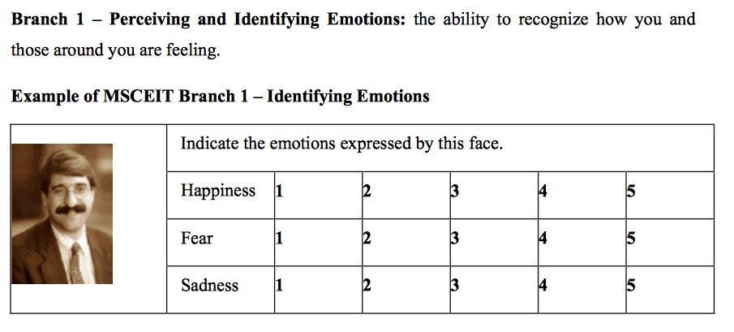
Experiential EIQ Measure: Perceiving Emotions conceived as an “ability” construct with correct/incorrect scoring (Mayers, Salovey et al )

Slide 12
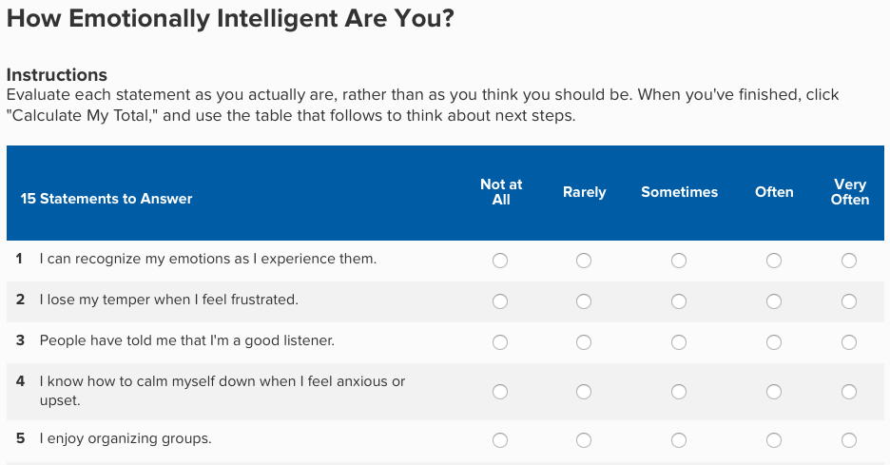
Emotional Intelligence conceived as a n non-cognitive construct (Daniel Goleman)

Slide 13
Response scale issues
Rate the product quality 1 =Poor, 2=Fair, 3=Good, 4=Very Good (Are we rating safety, adequacy of product, efficiency of behavior--confounding of too many indicators in one item, rater error variance high)
Did the clinician get client consent? Circle the chosen response.
1-2-3-4-5-6-7-8-9
( Yes/No would suffice, but too many response points, rater error variance high)
Does the student demonstrate knowledge of topic?
1=None, 2= Knows all, 3= Advanced
( Item and response options don’t fit , rater error variance high)
Better: To what extent….?
1. Not at all, 2 To some extent, 3 To a moderate extent, 4, To a great extent

